Slide 1
MIKE 11
HD Parameter Editor

Slide 2
HD PARAMETER EDITOR
Default Values and Hydrodynamic Settings
Network Editor (.nwk11)
Cross Section Editor (.xns11)
Simulation Editor (.sim11)
Boundary Editor (.bnd11)
HD Parameter Editor (.HD11)
Time Series Editor (.dfs0)

Slide 3
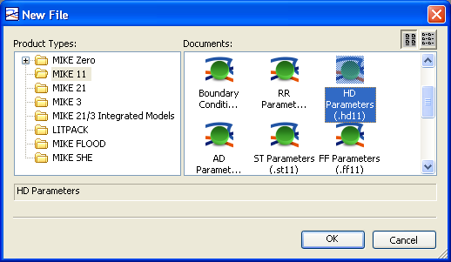
HD PARAMETER EDITOR
*.HD11 File Extension
How? MIKE Zero -> File -> New -> File -> MIKE 11 -> HD Parameters (.HD11)
HD Parameter Editor Contains Initial Conditions and Resistance Data

Slide 4
HD PARAMETER EDITOR
Initial Conditions Tab
Specify Global Values in This Panel
Local Conditions
Override Global Values
Tip: Initial Conditions Should Match Water Level Boundaries at First Time Step
Local Values Specified by Chainage (for Intermediate Locations Values are Linearly Interpolated)
Global and Local Initial Conditions

Slide 5
HD PARAMETER EDITOR
Bed Resistance Tab
Specify Global Values in This Panel
Local Conditions
Override Global Values
Lateral Resistance Factor in Cross-Section is Applied to Global or Local Values
If Lateral Resistance is Specified as a Value (not Factor), values in HD11 File are Ignored.
Local Values Specified by Chainage (for Intermediate Locations Values are Linearly Interpolated)
Global and Local Bed Resistance

Slide 6
HD PARAMETER EDITOR
Bed Resistance Definition
Global and Local Variables:
M = 30
Global Value
+
Local Values
(overwrites Global values at defined locations)
Resulting bed resistance
M = 30
M = 25
M = 20
Manning’s M
M = 30
M = 25
M = 20
0.0 5000 10000 15000 20000 Distance [m]

Slide 7
HD PARAMETER EDITOR
Wave Approximation Tab
Specify Global Wave Approximation in This Panel
Local Wave
Approximations Can
be Solved for Whole
or Part Branches
Kinematic or Diffusive Wave Can be Applied to Steep Channels with no Backwater or Tide Effects
Different Wave Approximations Can be Solved

Slide 8
HD PARAMETER EDITOR
Default Values Tab
Default
Simulation Constants
Delta and Zeta Min
can be used to Improve Model Stability

Slide 9
HD PARAMETER EDITOR
Additional Output Tab
Mark the check
boxes to save additional information to the result file
Separate File is Created with “HDAdd” added to the Name Specified in the Simulation Editor

Slide 10
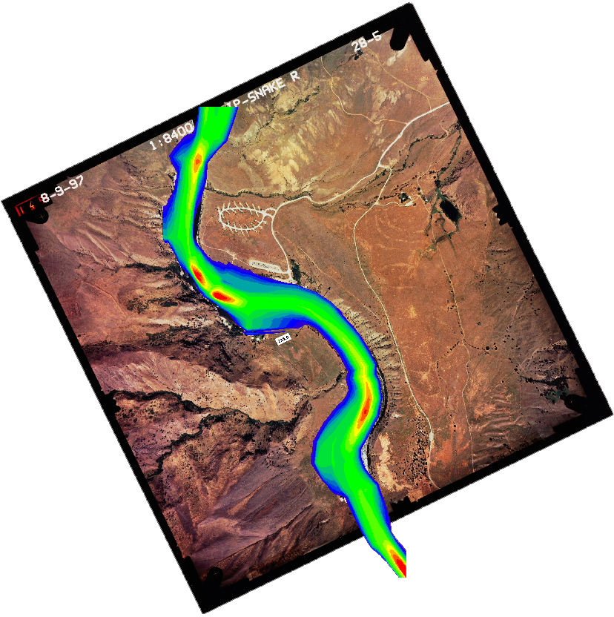
HD PARAMETER EDITOR
Maps Tab - Flood Mapping from 1-D Model

Slide 11
HD PARAMETER EDITOR
Maps Tab – for 1D FLOOD MAPPING
How? HD Parameter File -> Maps Tab
Uses Linear Interpolation between Cross-Sections
Map Position, Extent and Resolution are User Defined
Static or Dynamic Data (All or Part of Simulation Length)
Different Items can be Mapped eg. Level, Depth, Invert (DEM)
Advanced Maps can be made if 2-D Ground Data is Available

Slide 12
HD PARAMETER EDITOR
1-D FLOOD MAPPING
Grid File Definition (DFS2 File Type)
K
J
DFS2 Grid File

Slide 13
HD PARAMETER EDITOR
1-D FLOOD MAPPING
Type and Items to Map
Type:
Static (Max/Min)
Dynamic
Item:
Water level
Water depth
Velocity
Velocity * Depth
AD component
DEM
h,p,q
Component only used for AD

Slide 14
HD PARAMETER EDITOR
1-D FLOOD MAPPING
Temporal Settings (Dynamic Items Only)
Multiple of the Time Step in MIKE11
Full Period of Simulation
Start and End Times for Part Simulation

Slide 15
HD PARAMETER EDITOR
1-D FLOOD MAPPING
DEM Input Data Options
Use 2-D Data to Refine Mapping

Slide 16
HD PARAMETER EDITOR
DEM Output Options
DEM type can be used to make a grid of the channel geometry:
Channel only (Recommended)
Inserted directly into larger floodplain grid (improve DEM by burning river channel into the original DEM)
Best results achieved for: - small dX
- Cross-section extents defined using coordinates

Slide 17
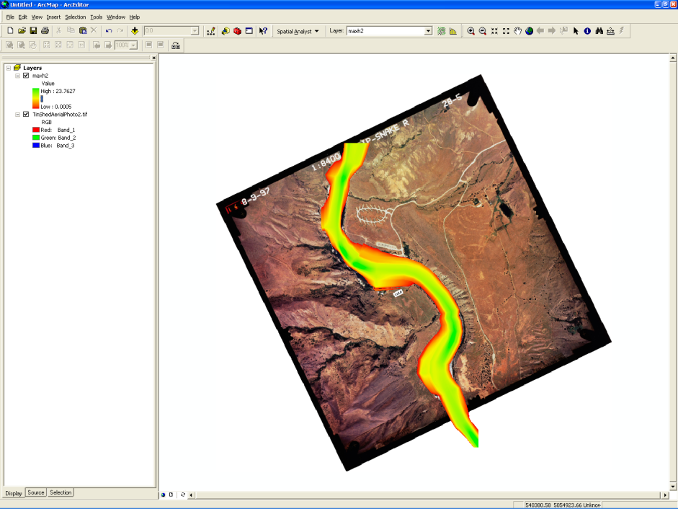
HD PARAMETER EDITOR
Visualising Mapping Results (*.dfs2)
Also:
Plot Composer
Result Viewer
MIKE Animator
Grid Editor
ArcGIS

Slide 18
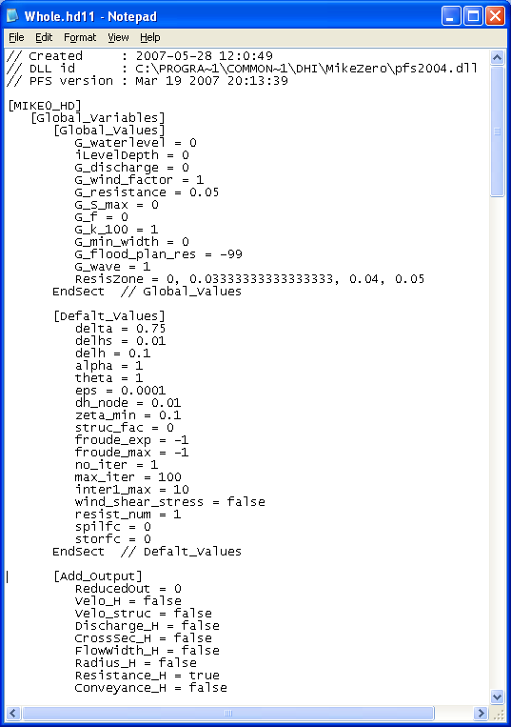
HD PARAMETER EDITOR
Editable Text File
The HD Parameter File can be Edited in any Text Editor

